Slide 1
Adv. Machine Learning Project Skin Cancer Classification Saad Iqbal

Slide 2
Problem Statement
Skin Cancer image classification into 7 categories using dataset of 10,015 images using 2 pre-trained models:
1- ResNet152
2- InceptionV3
Performance comparison of these two models was also done with custom CNN model.

Slide 3
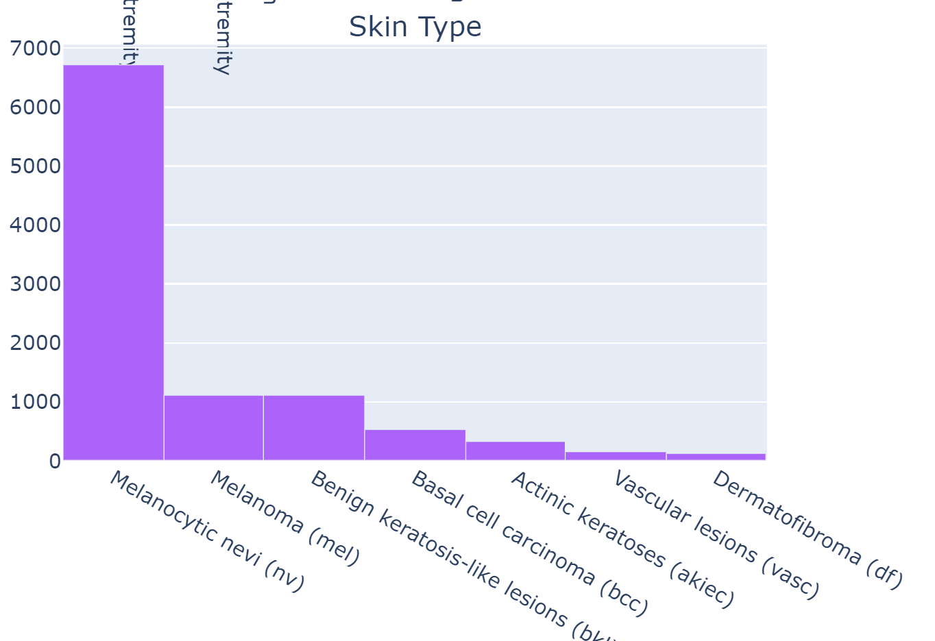
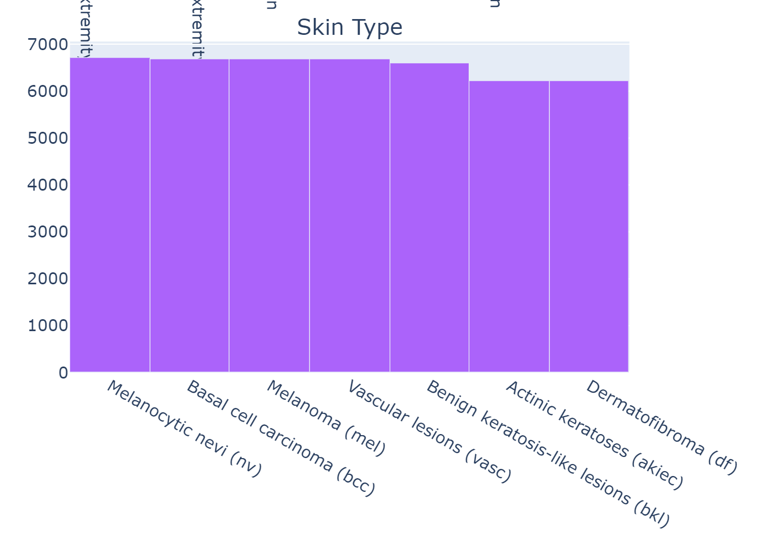
Data Preprocessing Steps
Null values in Age column of was filled with mean value
Class imbalance is handle by oversampling of minority classes
Categorical encoding of image labels was performed
File paths of images from two folders were into meta data file to use 10,015 images
Image Resize: CNN – 28x28; ResNet152 – 64x64; InceptionV3-128x128
For image Preprocessing and uploading used ImageDataGenerator
(10,015)
(45,756)

Slide 4
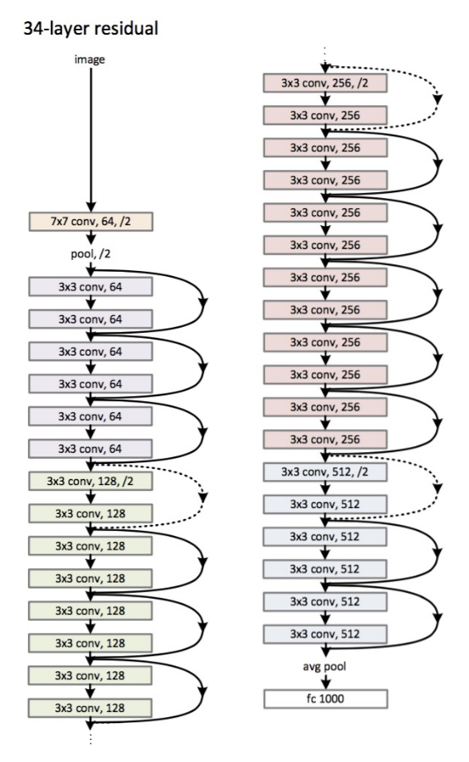
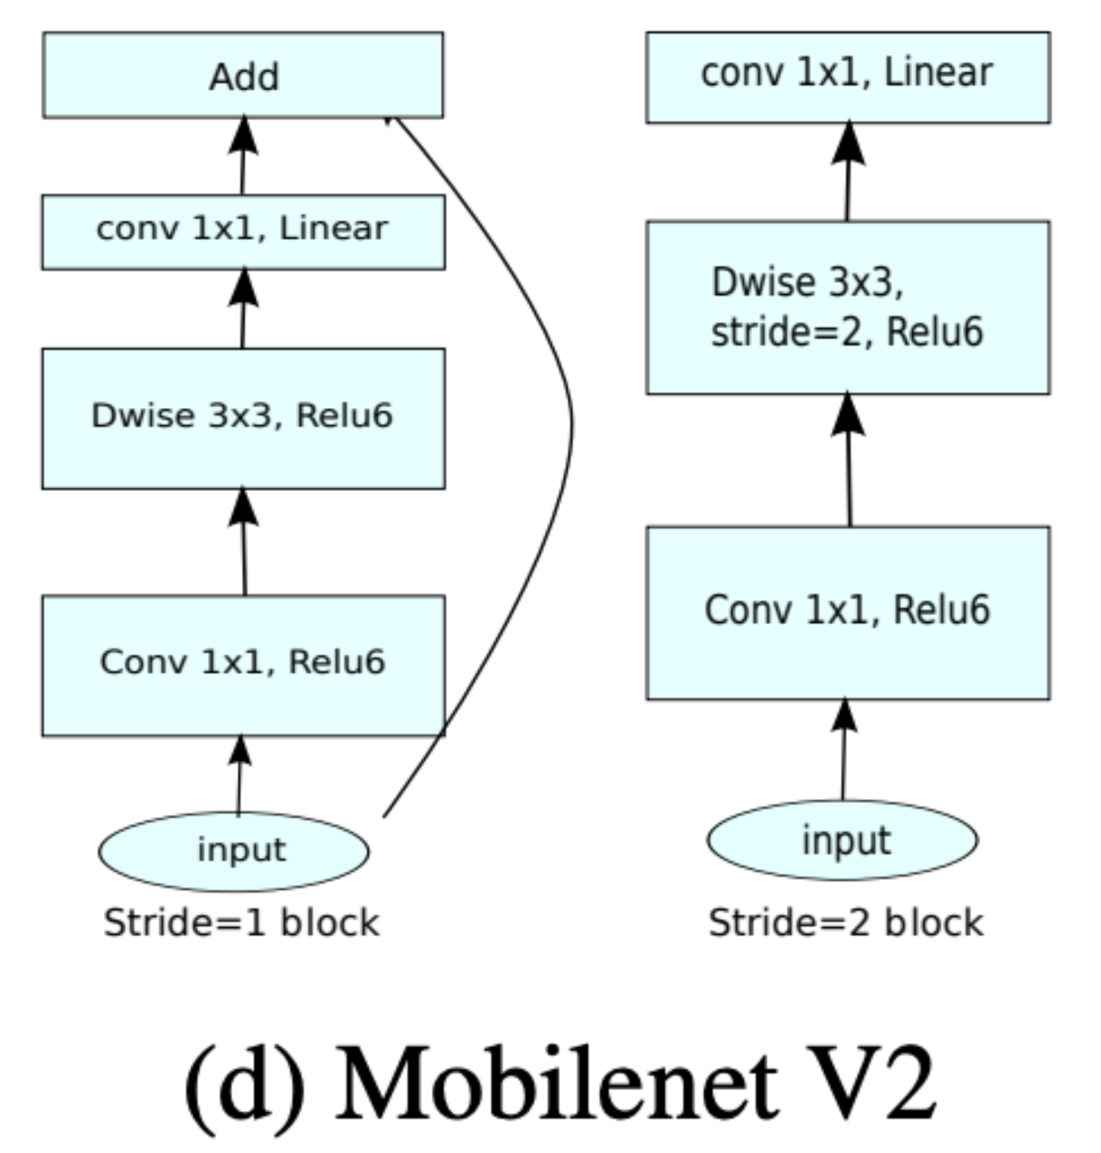
Pre Trained Models
Resnet 152 Architecture

Slide 5
Models’ Performance Comparison

Slide 6
Algorithms used for Modeling
Model 1: ResNet152 - Test Accuracy = 97.88%
Feature Extraction Conv2D layers: ResNet152
Classification Layers:
Dense layers: 128, 64, 32, 7
Batch Normalization, Dropout, L2 regularization
Activation: Relu, Softmax
Optimizer: Adam with Initial learning rate= 0.001
Cost function: sparse_categorical_crossentropy
Code Link: https://github.com/SaadIqbalGH/Deep-Learning-CNN-Transfer-Learning-DCGAN/blob/main/Skin_Cancer_ResNet152.ipynb

Slide 7
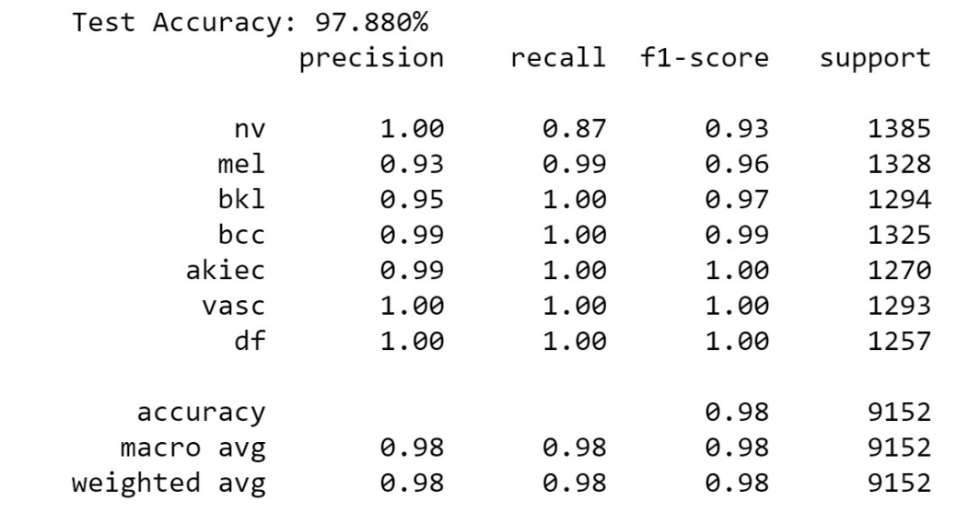
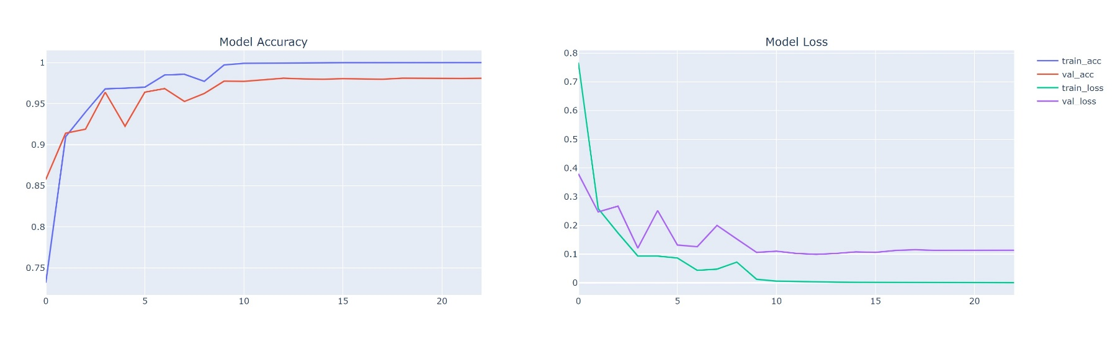
Performance Matrix – ResNet152

Slide 8
Algorithms used for Modeling
Model 2: Custom CNN - Test Accuracy = 97.98%
Conv2D 3x3 filters: 16, 32, 64, 128
Dense layers: 64, 32, 7
Max Pooling (2x2)
Activation: Relu, Softmax
Optimizer: Adam with Initial learning rate= 0.001
Cost function: sparse_categorical_crossentropy
Code Link: https://github.com/SaadIqbalGH/Deep-Learning-CNN-Transfer-Learning-DCGAN/blob/main/Skin_Cancer_CNN.ipynb

Slide 9
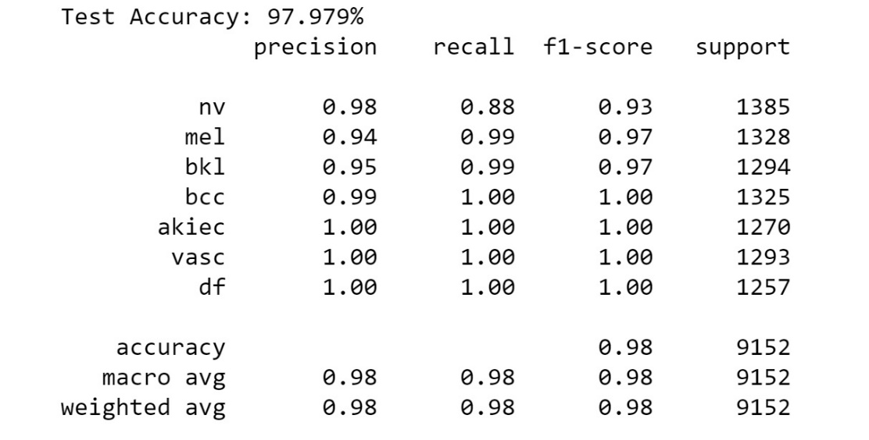
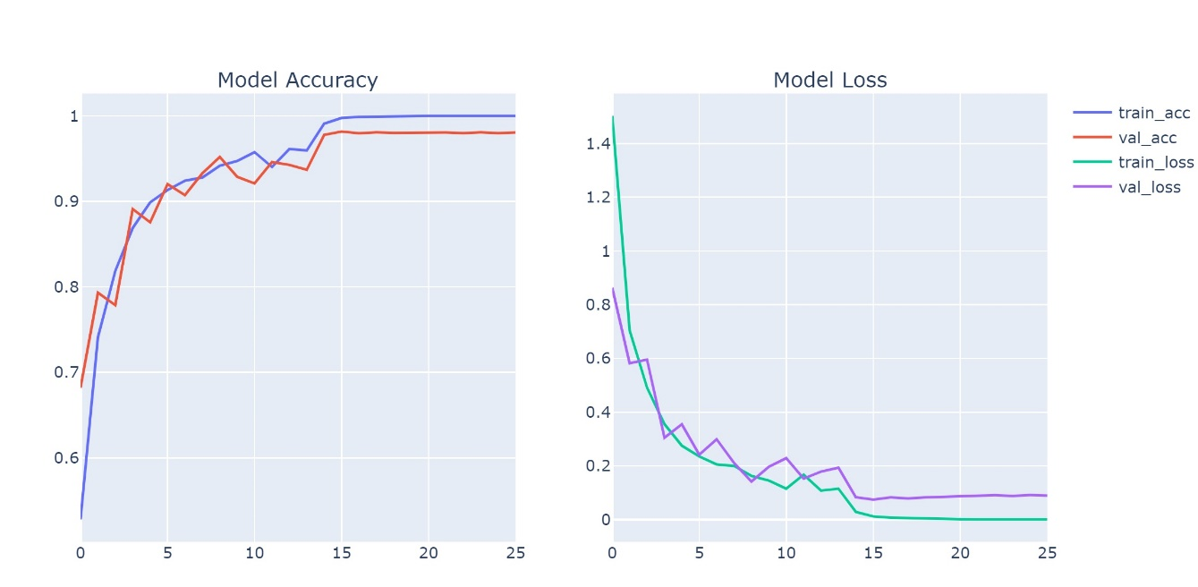
Performance Matrix – Custom CNN

Slide 10
Algorithms used for Modeling
Model 3: MobileNetV2 - Test Accuracy = 93.89%
Feature Extraction Conv2D layers: MobileNetV2
Classification Layers:
Dense layers: 128, 64, 32, 7
Batch Normalization, Dropout, L2 regularization
Activation: Relu, Softmax
Optimizer: Adam with Initial learning rate= 0.001
Cost function: sparse_categorical_crossentropy
Code Link:
https://github.com/SaadIqbalGH/Deep-Learning-CNN-Transfer-Learning-DCGAN/blob/main/Skin_Cancer_MobileNetV2_.ipynb

Slide 11
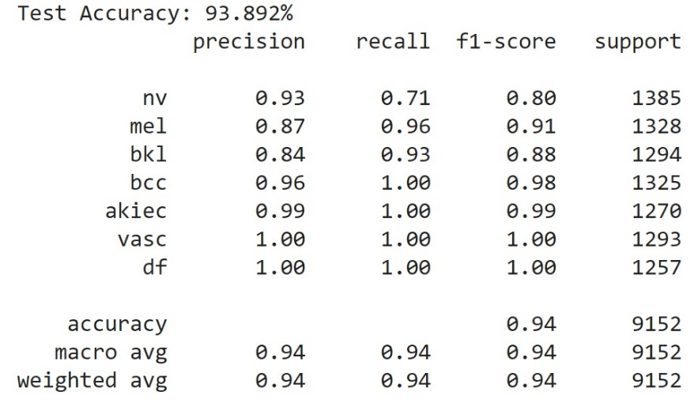
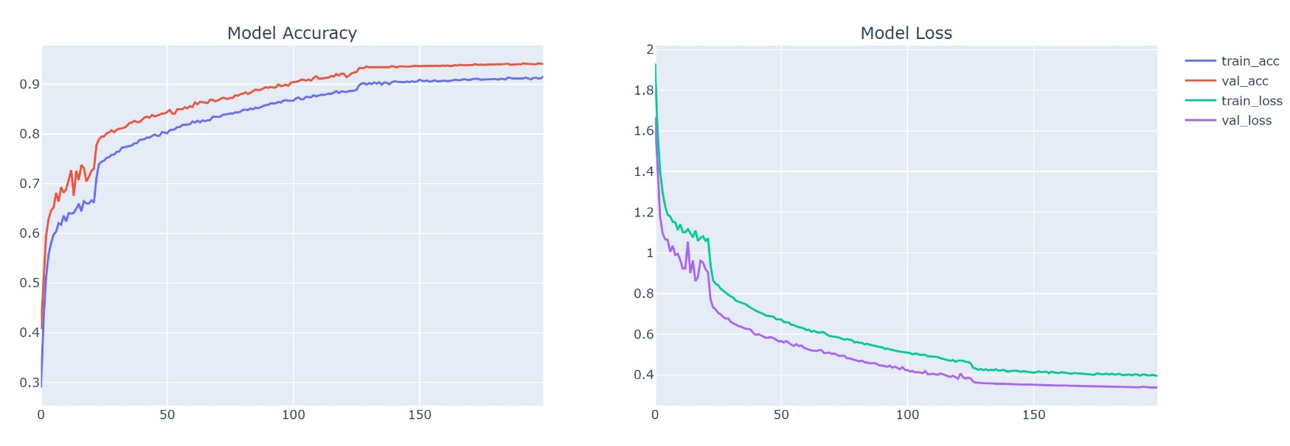
Performance Matrix – MobilenetV2

